Slide 1
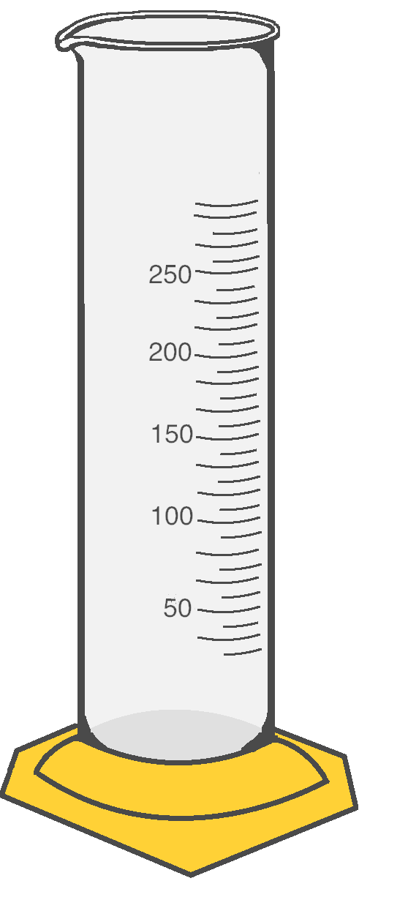
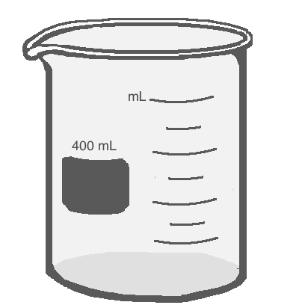


Scientific Method Applied

Slide 2
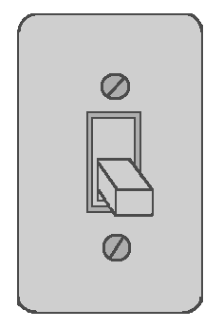
Scientific Method
Every time you solve a problem, you are using the Scientific Method.
You use some form of the Scientific Method everyday without even thinking about it!
For instance, when you walk into a dark room you are faced with a problem: you can’t see. You know that you can turn the lights on with a light switch. You test this by flipping the switch. If the lights come on, you can conclude that the lights were turned off. If not, then maybe the bulbs are burnt out. To solve that simple problem, you naturally follow the steps of the scientific method!

Slide 3
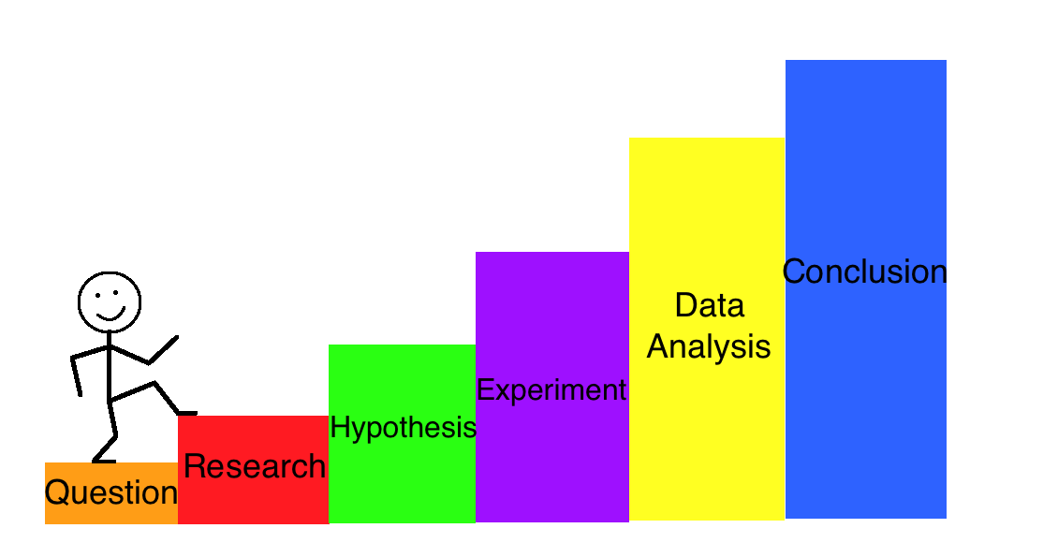
Steps of the Scientific Method
Problem/question
Research
Hypothesis
Procedure/Experiment
Analyze data
Conclusion

Slide 4

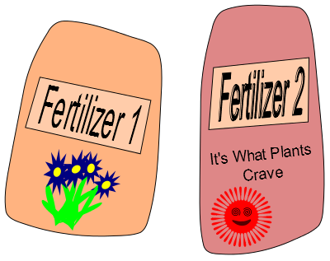
Question/Problem
Everyday you are faced with problems or come up with questions. Having a Question is the first step to finding the solution.
For example, you bought seeds for your favorite flower but are not sure what the best fertilizer to use is.
You have two types of fertilizer in your garage so you come up with the Question:
Which fertilizer will make my flower grow taller: Fertilizer 1 or Fertilizer 2?

Slide 5

Research
To begin answering your question, you have to Research the topic your experiment is on.
For example, if you researched plant fertilizers you would find that they have different nutrients in them. Some are better for making plants bigger and some are better for making them flower more.
Different fertilizers have different amounts of these nutrients for the plants.
You see Fertilizer 1 has a lot of flowering nutrients in it while Fertilizer 2 has lot of growth nutrients.

Slide 6

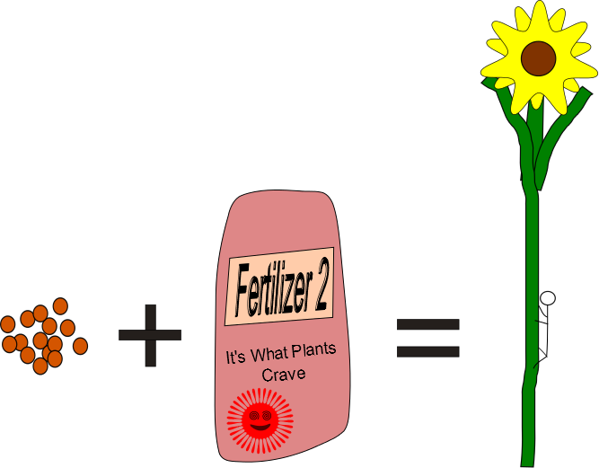
Hypothesis
Researching the topic of your experiment gives you the information you need to create a prediction of how your experiment will end. This prediction is called a Hypothesis. Based on your research, you can make the following Hypothesis:
If you use Fertilizer 1 on Plant A and Fertilizer 2 on Plant B, then you can expect Plant B to grow taller because its fertilizer has more growth nutrients.

Slide 7
Hypothesis: Continued
Most of the time a hypothesis turns out to be incorrect, but that’s okay. They are not supposed to be right all of the time. They are just your guess at what will happen based on what you know.
This is why you always have to set up an experiment to test and see what really happens.
If your hypothesis is correct then you can use your research and experiment to explain why.
If it is incorrect, then you can look at your experiment and try to explain what happened. It is possible that you overlooked something in your research.

Slide 8
Design the Experiment
Now you have to create an Experiment to test your hypothesis to see if it is correct or not.
You need to figure out what the Variables are. A Variable is something that changes (varies).
Type of Fertilizer
Which day you measure the height
Height of the plants
There are two types of variables.
Independent Variable: It does not depend on the other variables. This is the variable that you control.
Dependent Variable: This variable depends on the other variables. It is the variable that you are trying to measure.
The Experiment: To test how the height depends on the type of fertilizer used, you will plant the seeds in the same soil, give them the same amount of water, sunlight, and fertilizer, but give them different types of fertilizer. Then you will record the heights of the plants as they grow for several days and see which plant turns out to be taller.

Slide 9
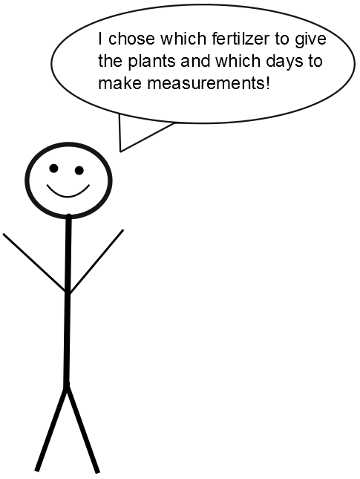
Independent Variables
Fertilizer: The type of fertilizer that you use is your choice. It does not depend on the height of the plants or on the day so it is an Independent Variable.
Day: You will make measurements on different days, but the days do not depend on the fertilizer or the height of the plants. Therefor the day is an Independent Variable.

Slide 10
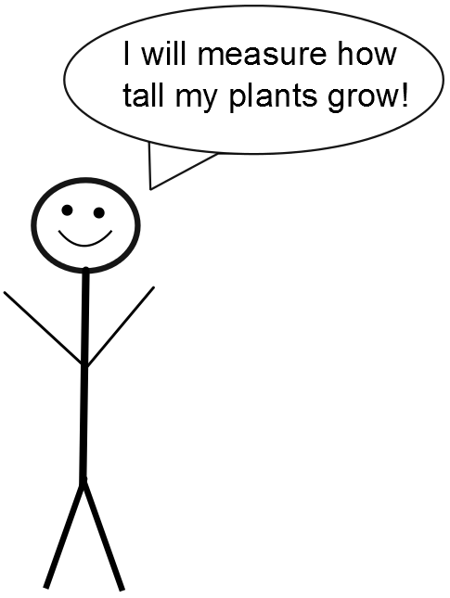
Dependent Variables
Height of the Plants: The height of the plants (according to your hypothesis) should change depending on which fertilizer you use. Because this variable depends on another variable, the Height of the Plants is a Dependent Variable.

Slide 11
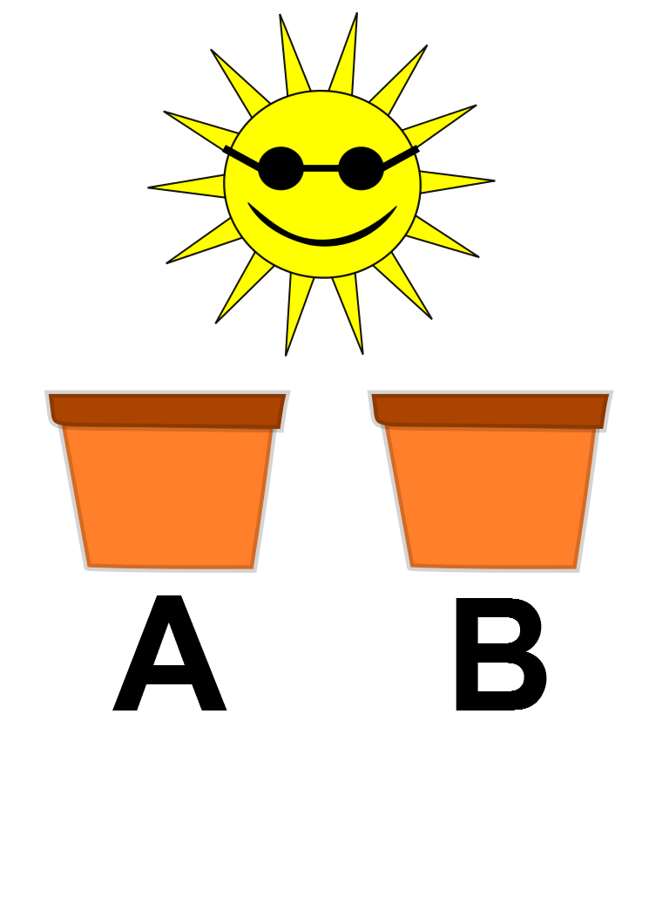

Perform Experiment
You plant the seeds for Plant A and Plant B with the same amount of soil, water, sunlight, and fertilizer. However, Plant A receives Fertilizer 1 and Plant B receives Fertilizer 2.
You record the heights of Plant A and Plant B for 4 days in a row once they start sprouting.

Slide 12
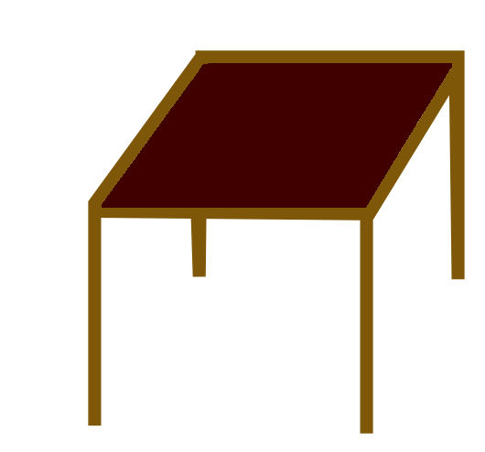

Make a Table
When conducting an experiment, it is always important to record your observations. These observations are the data.
Data is a collection of results and observations that you can refer to later on to help you learn about what happened during your experiment. To organize the data better we use Tables.
Before starting your experiment you will draw a blank table and then fill it in as you make observations/collect data.
Tables have columns (vertical – like columns on buildings) and rows (horizontal – like rows or corn across a field).
Variable 1 | Variable 2 | Variable 3
Data | Data | Data
Data | Data | Data
Data | Data | Data

Slide 13
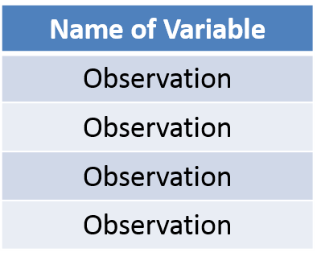
Tables: Columns
Each column of a table is for one variable. If you have three variables, then you will need three columns.
In our experiment we have three variables.
The Day (independent variable)
Height of Plant A (dependent variable)
Height of Plant B (dependent variable)
This is a Column
The top of the column is where you put the name of your variable.

Slide 14
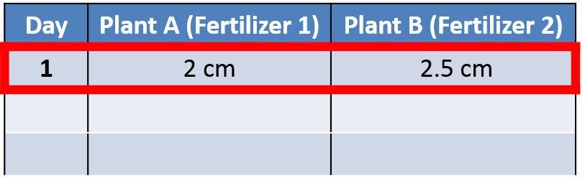
Tables: Rows
Each row of a table is for a set of observations for your variables.
For example: On Day 1 you measure Plant A to be 2 cm tall and Plant B to be 2.5 cm tall.
The first row has each of these observations recorded in the correct columns. The Day column has a 1, the Plant A column has 2 cm, and the Plant B column has 2.5 cm
Day | Plant A (Fertilizer 1) | Plant B (Fertilizer 2)
1 | 2 cm | 2.5 cm
This is the first row where we put our first observation for each variable.
This is a Row

Slide 15
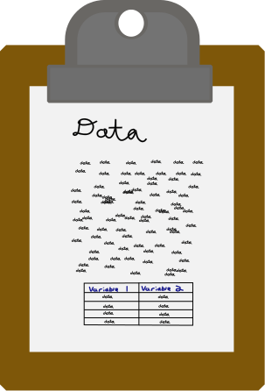
Record the Data
You continue to make measurements of the plants for each day and record the following values:
Day 2: Plant A was 7.5 cm tall and Plant B was 10 cm tall
Day 3: Plant A was 13 cm tall and Plant B was 17 cm tall
Day 4: Plant A was 15 cm tall and Plant B was 25 cm tall
Record this data in the table below.
Kids’ Tech University Rules
Day | Plant A (Fertilizer 1) | Plant B (Fertilizer 2)
1 | 2 cm | 2.5 cm
2 | 7.5 cm | 10 cm
3 | 13cm | 17cm
4 | 15 cm | 25cm

Slide 16
Data Analysis
To understand your data, you must analyze it by putting it in to tables, charts, and graphs. This allows you to view your data more clearly to help you reach a conclusion (answer) for your problem/question.
You put your results in to a table and translated your data into a bar graph, a line graph, and even a pie chart. Looking at your results from different perspectives helps you reach a conclusion accurately. Based on the graphs of your data so far, what seems to have been the overall result of your experiment?

Slide 17
Bar Graphs
Effect of Type of Fertilizer on Plant Growth
Y Axis
30
Bar Graphs are used to show the total change in something.
For our example, we took the final height of Plant A and the final height of Plant B from our chart and displayed it on this graph. As you can see, the Independent Variable (the type of fertilizer used) goes on the X axis. The Dependent Variable (the height of the plant) goes on the Y axis. By displaying our data this way, we are able to easily see that Plant B grew taller using Fertilizer 2 than Plant A did using Fertilizer 1.
25
20
Plant Height (cm)
15
Plant A
Plant B
10
5
0
X Axis
Fertilizer 1
Fertilizer 2
Type of Fertilizer Used

Slide 18
Going Further
We saw from the Bar Graph that our hypothesis was correct and Plant B grew taller!
However, we can learn even more about our experiment from the data that we have.
We can make a line graph and see how the plants grew over time and compare them.
Then we will know both how the plants grow and which one we can expect to grow taller.

Slide 19
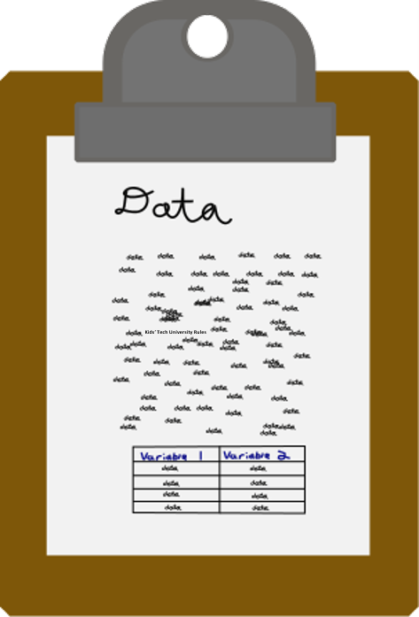

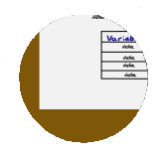

Slide 20
Graphs
Y Coordinates
Y Axis
Graphs show us the relationship between two Variables. Graphs display data so that we can see and understand it more clearly. A Graph is usually made of two lines that form a right angle and where those two lines meet is called the origin. These lines are called Axes. The vertical line on the graph is called the Y Axis and the horizontal line on the graph is called the X axis. The Y Axis represents the Dependent Variable and the X Axis represents the Independent Variable. One of the most important parts about graphs is that they allow us to see Patterns and Trends within our data.
1
2
3
4
5
6
7
8
9
10
Dependent Variable
Origin
0
X Axis
0
1
2
3
4
5
6
7
8
9
10
X Coordinates
Independent Variable

Slide 21
Y Axis
Coordinates are expressed as (x value, y value)
y = 6
(7,6)
1
2
3
4
5
6
7
8
9
10
Dependent Variable
x = 7
0
X Axis
0
1
2
3
4
5
6
7
8
9
10
Independent Variable

Slide 22
Scatter Plots
Effect of Type of Fertilizer on Plant Growth
Y Axis
Scatter Plots are a way of plotting multiple data points on one graph. They can help us see patterns and trends.
For our example, we took all of the height measurements for Plant A and Plant B from our chart and displayed it on this plot. As you can see, the Independent Variable (the type of fertilizer used) goes on the X axis. The Dependent Variable (the height of the plant) goes on the Y axis.
What patterns do you see for Plant A (the blue dots) and Plant B (the red dots).
30
25
Key
20
Plant A (Fertilizer 1)
Plant Height (cm)
15
Plant B (Fertilizer 2)
10
5
0
X Axis
1
2
3
4
Time (Days)

Slide 23
Independent Variable
Y Axis
An Independent Variable is the part of the experiment that you choose to change. When you change something in an experiment you are trying to find the answer to your problem or question. The Independent variable in our example experiment is changing which type of fertilizer the two plants are given. This is the independent variable in this experiment because we are controlling the type of fertilizer Plant A and Plant B receive. The Independent Variable will always be shown on the X axis (horizontal axis) of the graph.
X Axis
Independent Variable

Slide 24
Dependent Variable
Dependent Variable
Y Axis
The Dependent Variable is the part of the experiment that you can not directly control. It is the variable that you want to measure in the experiment. The Dependent Variable in our example experiment is the height of your two plants. This is the dependent variable because it is the change that we can not control, the change in the plants’ height depends on which fertilizer they are given. The Dependent Variable will always be shown on the Y axis (vertical axis) of the graph.
X Axis

Slide 25
Line Graphs
Effect of Type of Fertilizer on Plant Growth
Y Axis
Line Graphs show how something changes over time. Line graphs help us see trends (patterns) in how things change over time.
For our example, we took all of the height measurements for Plant A and Plant B from our chart and displayed it on this graph. As you can see, the Independent Variable (the type of fertilizer used) goes on the X axis. The Dependent Variable (the height of the plant) goes on the Y axis. Since this graph includes time, it helps us see that Plant B grew taller AND faster than Plant A.
30
25
Key
20
Plant A (Fertilizer 1)
Plant Height (cm)
15
Plant B (Fertilizer 2)
10
5
0
X Axis
1
2
3
4
Time (Days)

Slide 26
Patterns
Y Axis
Graphs are a major way that we express data so that we can visualize our data better. Graphs also allow us to see Patterns that form in our data. A Pattern is when data is repeated in a way that shows a sequence.
For example, this line is increasing. This is a pattern because each individual point that makes up the line is increasing. So, the data points form a pattern and when they are put into a graph, it gives us a larger picture. This larger picture makes it very clear to see that our data points are increasing.
Increasing points create a pattern
X Axis

Slide 27
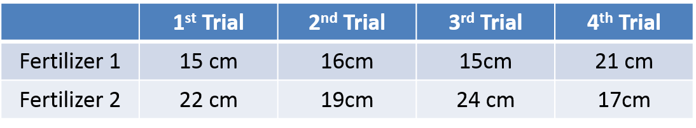
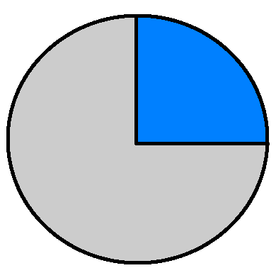
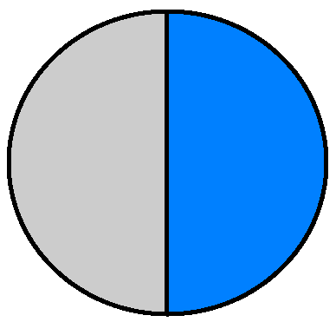
 | 1st Trial | 2nd Trial | 3rd Trial | 4th Trial
Fertilizer 1 | 15 cm | 16cm | 15cm | 21 cm
Fertilizer 2 | 22 cm | 19cm | 24 cm | 17cm
Pie Charts
Final Plant Heights
Pie Charts help us look at fractions of a whole. Percentages and fractions represent what proportion of a group had a certain result.
For our example experiment, we decided to do multiple trials of testing Fertilizer 1 and Fertilizer 2. This time, we wanted to see how many plants grew over 20 cm for fertilizer 1 and fertilizer 2. We decided to test four plants using Fertilizer 1 and four plants using Fertilizer 2. The table expresses the results of the experiment. As you can see, it is much easier to understand the percentage of plants that grew over 20 cm for fertilizer 1 versus fertilizer 2 when it is in the form of pie charts.
25% Grew over 20 cm
50%
50% Grew over 20 cm
75%
Fertilizer 1
Fertilizer 2

Slide 29
Conclusion
After analyzing all of your data by creating different types of graphs, it is clear that using Fertilizer 2 made Plant B grow taller than Plant A. The Bar Graph helped you understand that after four days, Fertilizer 2 helped Plant B grow to 25 centimeters while Fertilizer 1 only helped Plant A grow to 20 centimeters. The Line Graph helped you see that Fertilizer 2 helped Plant B grow taller and faster than Fertilizer 1 did for Plant A. When you completed this experiment multiple times to create your pie charts, you also learned that Fertilizer 2 consistently makes plants grow taller than Fertilizer 1. All of these different expressions of your results helps you to reach your conclusion.
Let’s think back to our Question: What type of fertilizer will make my favorite type of flower grow the tallest, Fertilizer 1 or Fertilizer 2?
Based on your results and graphs, we can come up with a conclusion/answer to the above question:
Fertilizer 2 helped Plant A reach 25cm while Fertilizer 1 only helped plant B reach 20cm. When this experiment was repeated, Fertilizer 2 consistently produced taller plants than Fertilizer 1. Overall, Fertilizer 2 will help make my favorite type of flower grow the tallest.

Slide 30
Measurement Tools

Slide 31
Going between standard measurement & US measurement. Also switching between units

